Slide 1



Detailed orders and logistics analysis
View in Power BI
Last data refresh:
7/27/2025 9:46:28 AM UTC
Downloaded at:
7/27/2025 9:48:46 AM UTC

Slide 2
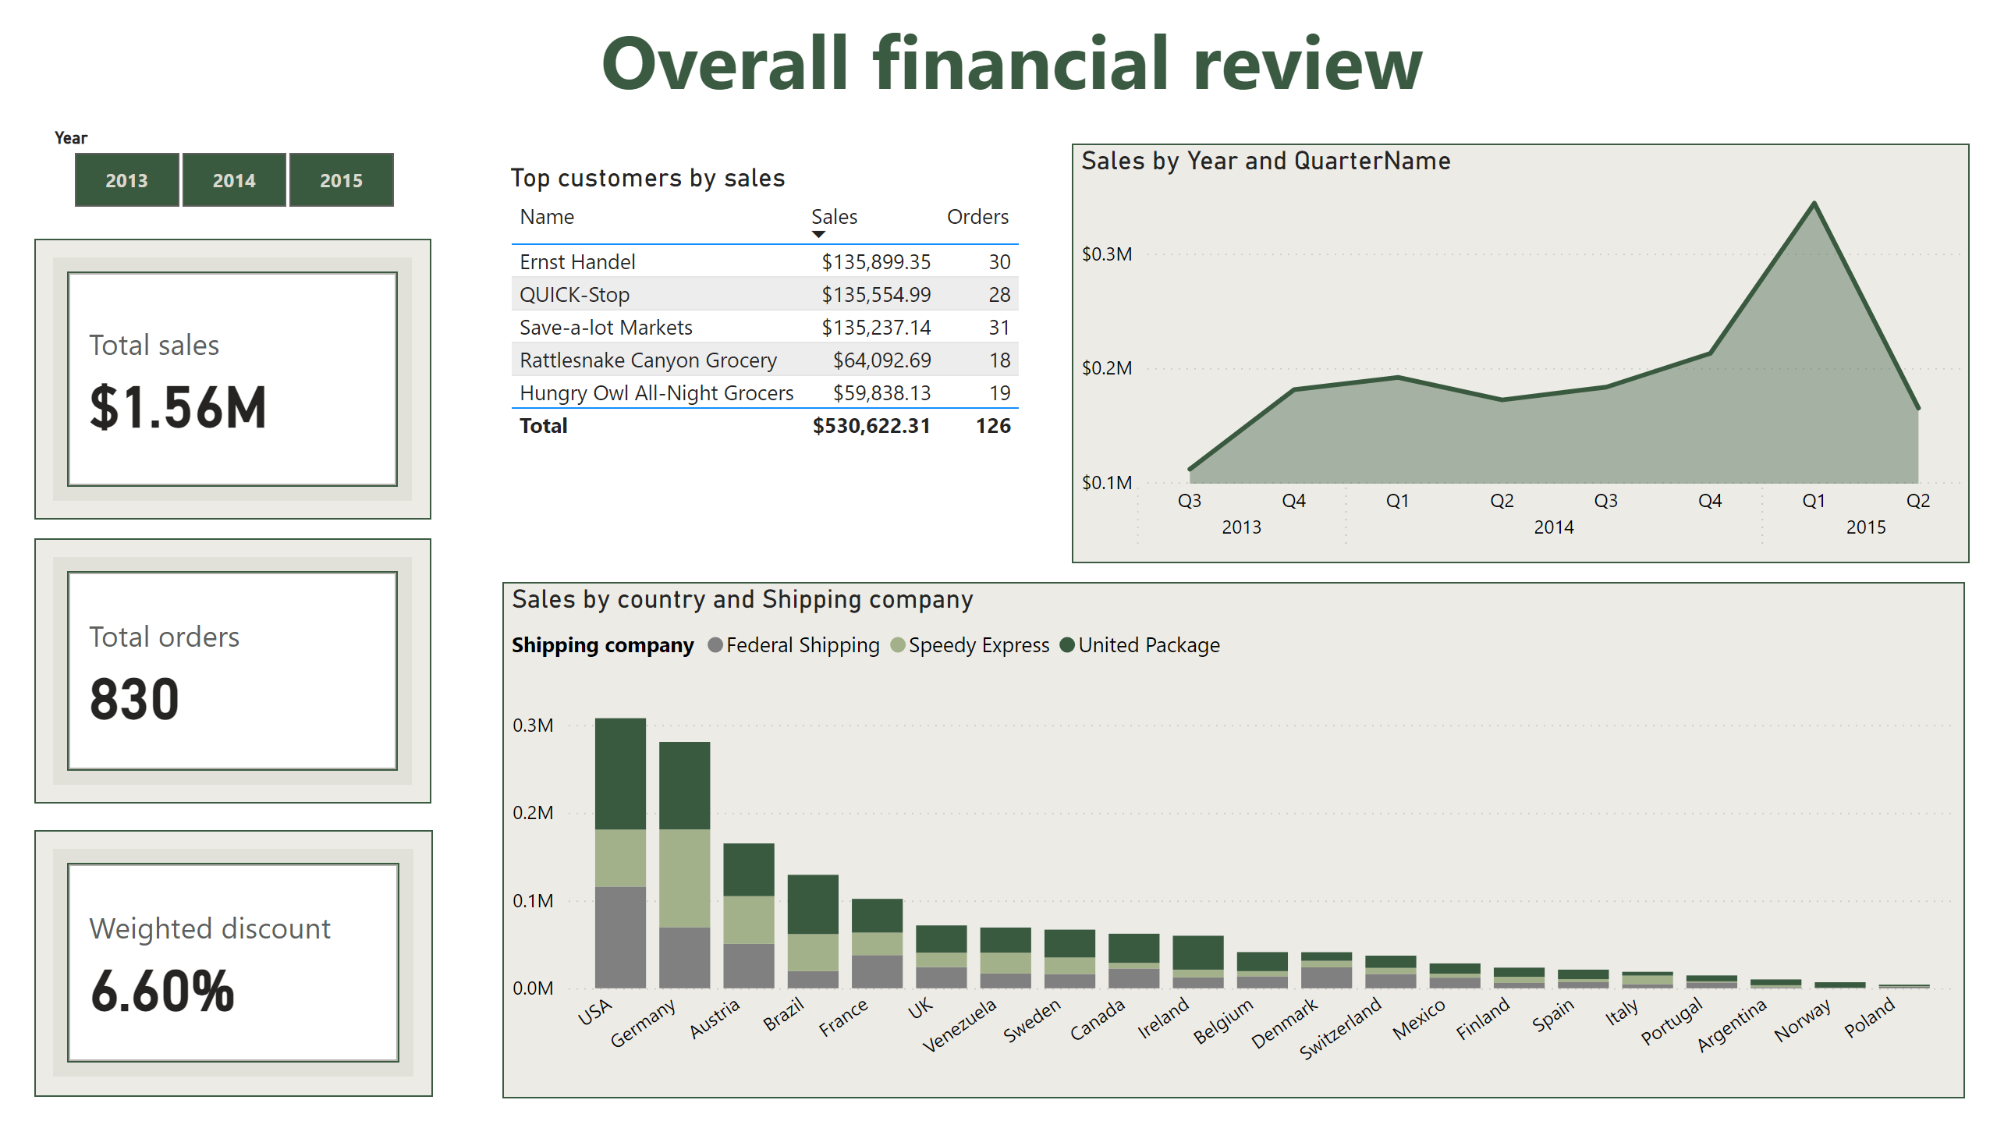
main
Notes:
areaChart
No alt text provided
cardVisual
No alt text provided
cardVisual
No alt text provided
textbox
No alt text provided
Top customers by sales
No alt text provided
cardVisual
No alt text provided
columnChart
No alt text provided
slicer
No alt text provided

Slide 3
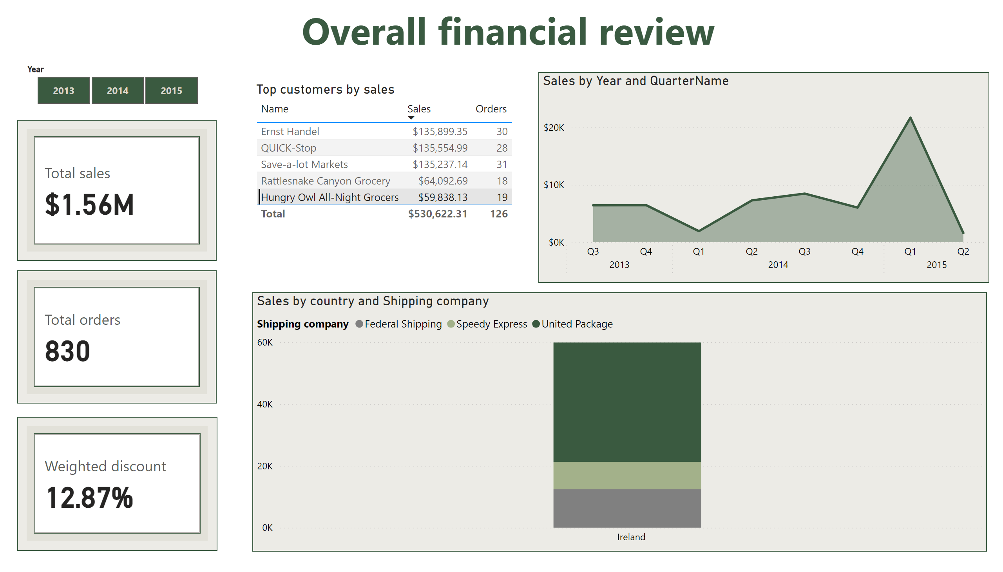
main
Notes:
areaChart
No alt text provided
cardVisual
No alt text provided
cardVisual
No alt text provided
textbox
No alt text provided
Top customers by sales
No alt text provided
cardVisual
No alt text provided
columnChart
No alt text provided
slicer
No alt text provided

Slide 4
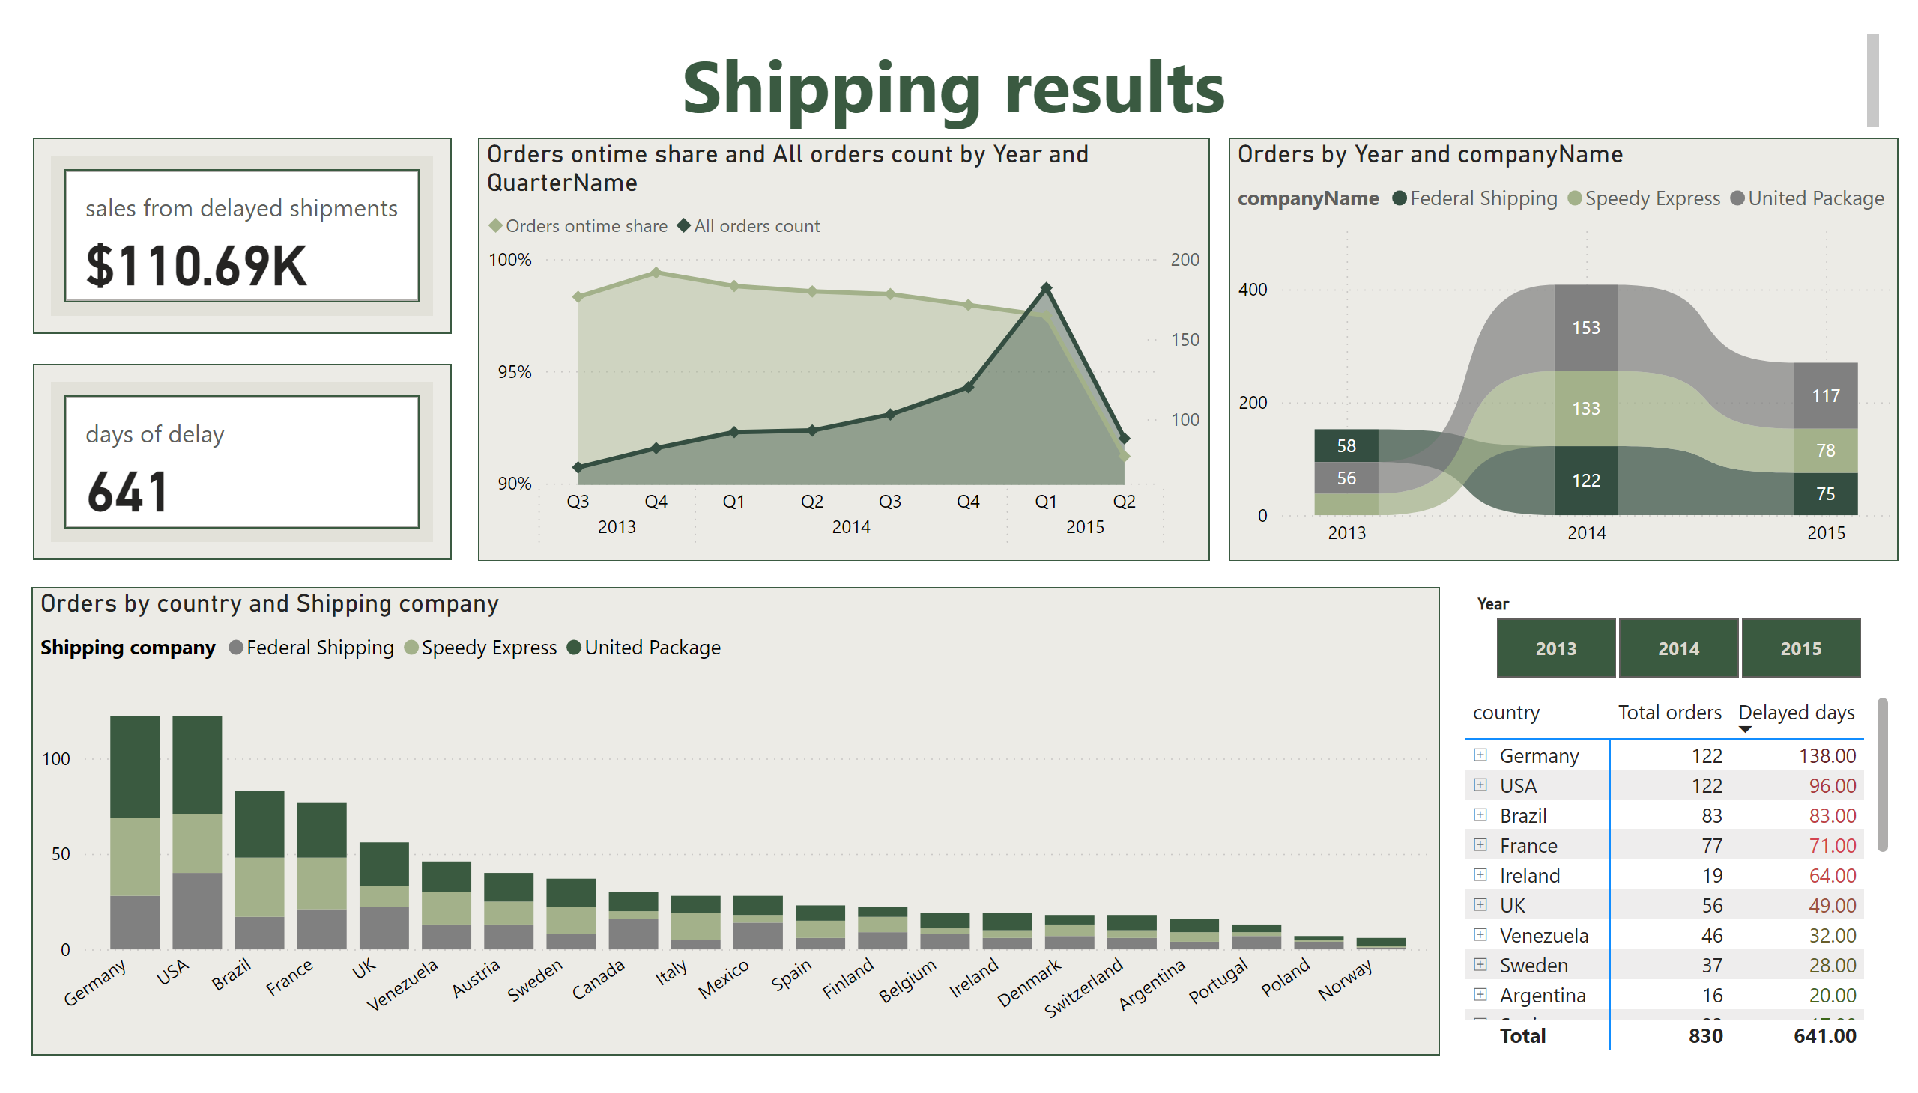
shipping
Notes:
areaChart
No alt text provided
pivotTable
No alt text provided
ribbonChart
No alt text provided
columnChart
No alt text provided
textbox
No alt text provided
cardVisual
No alt text provided
cardVisual
No alt text provided
slicer
No alt text provided

Slide 5
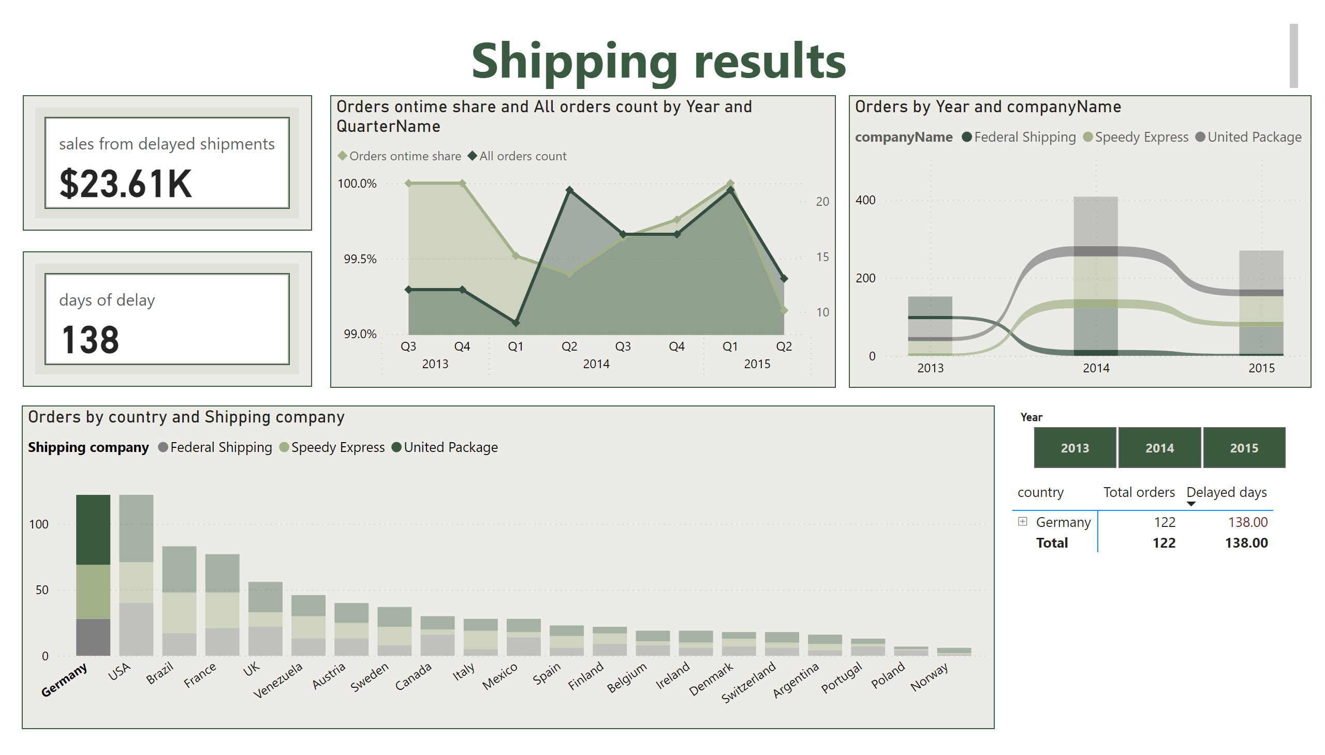
shipping
Notes:
areaChart
No alt text provided
pivotTable
No alt text provided
ribbonChart
No alt text provided
columnChart
No alt text provided
textbox
No alt text provided
cardVisual
No alt text provided
cardVisual
No alt text provided
slicer
No alt text provided

Slide 6
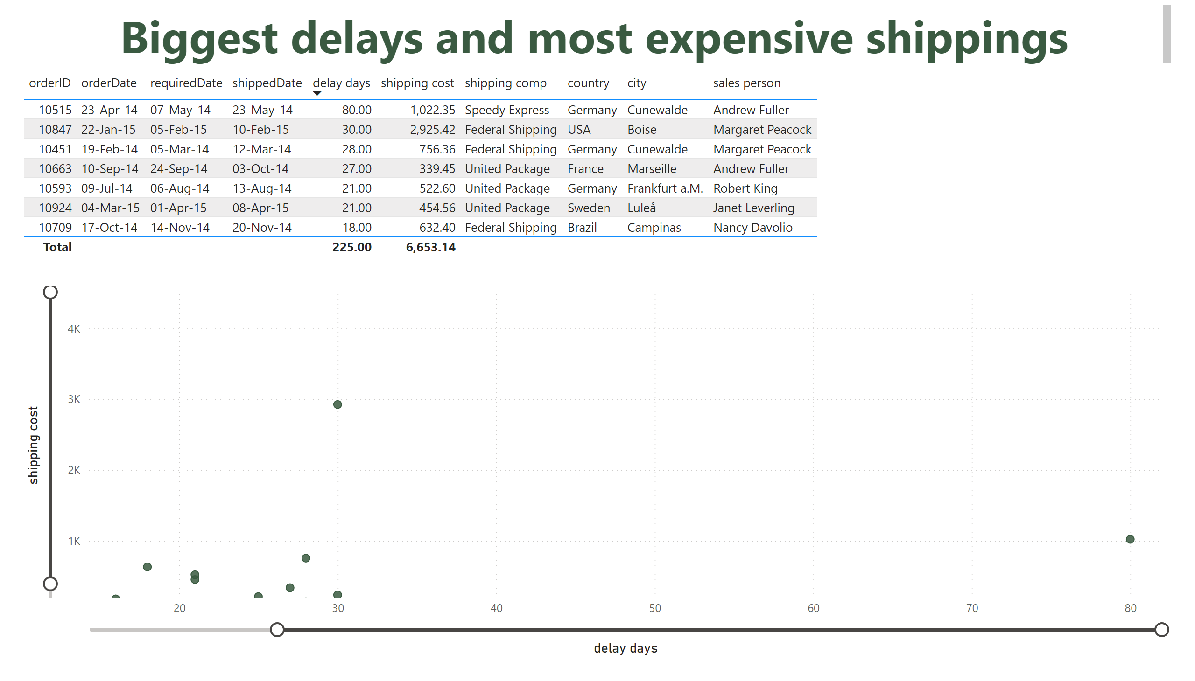
top shipping issues
Notes:
scatterChart
No alt text provided
tableEx
No alt text provided
textbox
No alt text provided

Slide 7
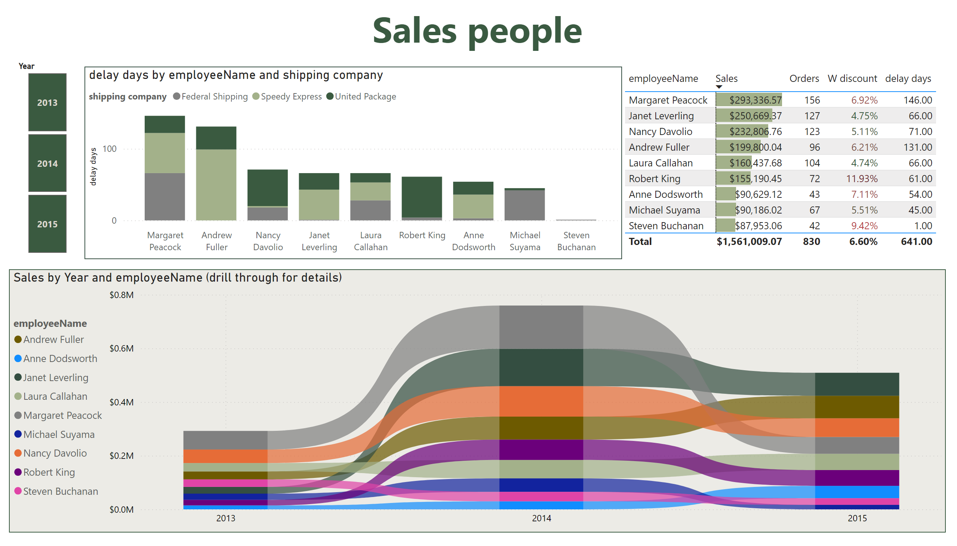
sales
Notes:
tableEx
No alt text provided
textbox
No alt text provided
Sales by Year and employeeName (drill through for details)
No alt text provided
slicer
No alt text provided
columnChart
No alt text provided

Slide 8
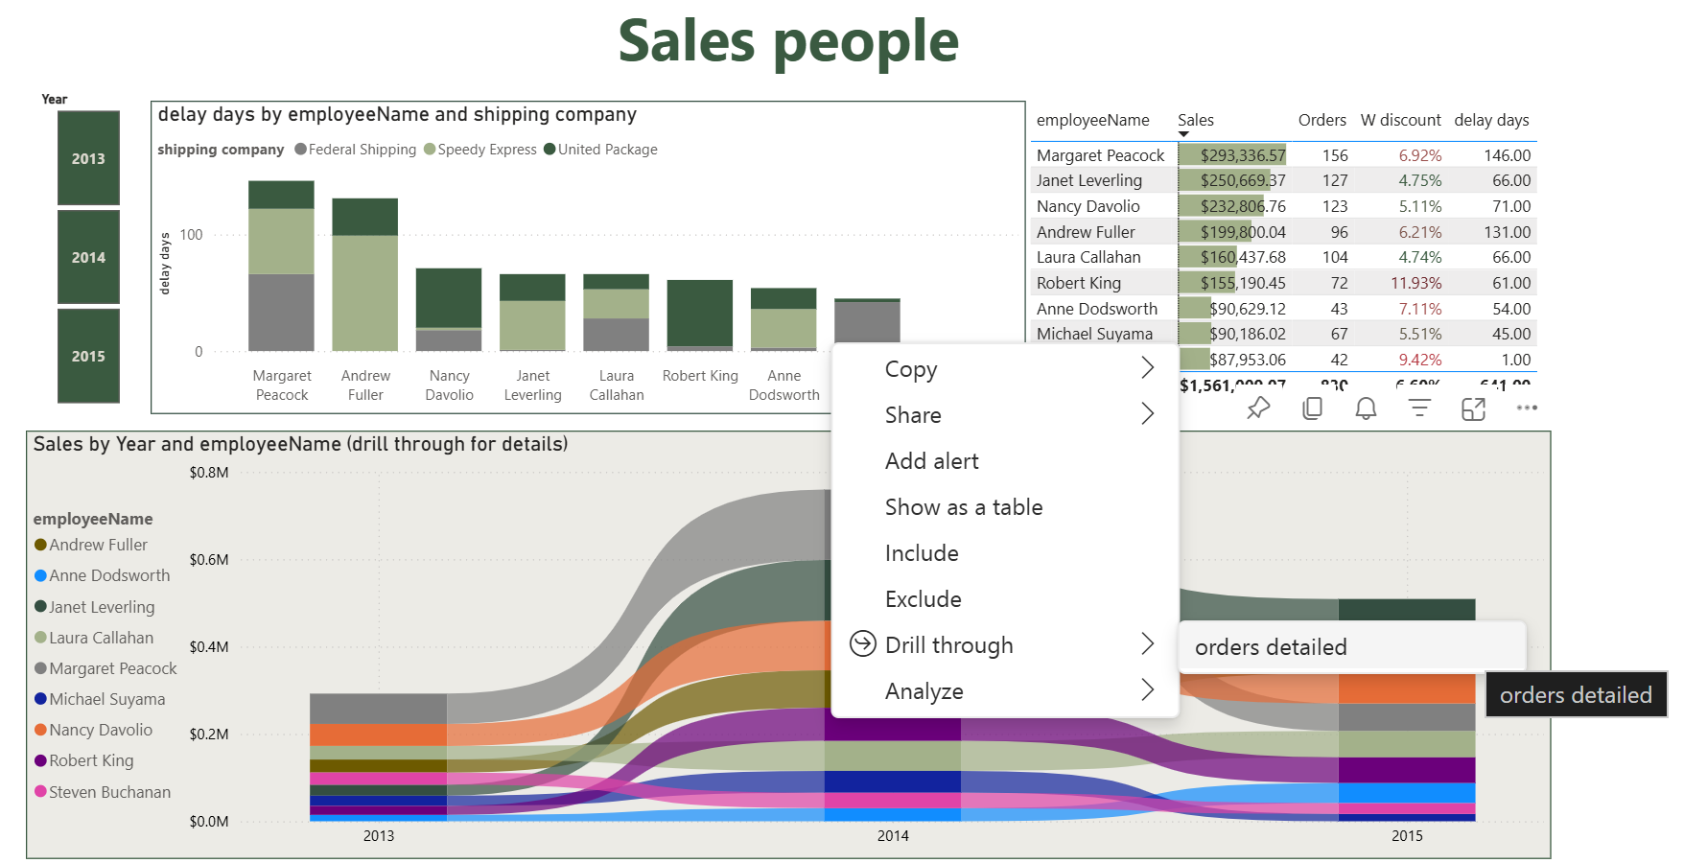

Slide 9
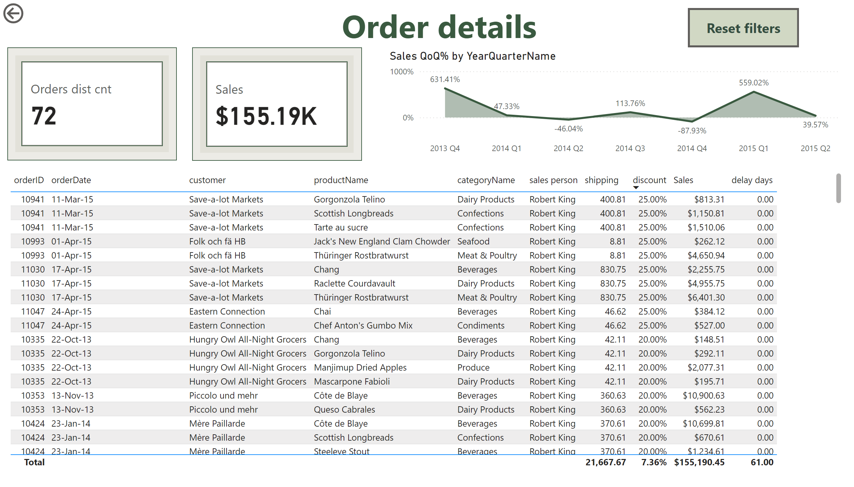
orders detailed
Notes:
tableEx
No alt text provided
actionButton
No alt text provided
textbox
No alt text provided
actionButton
No alt text provided
cardVisual
No alt text provided
areaChart
No alt text provided
cardVisual
No alt text provided

Slide 10
I thank you for your questions and time.
View in Power BI
Last data refresh:
7/27/2025 9:46:28 AM UTC
Downloaded at:
7/27/2025 9:48:46 AM UTC

